Slide 1
Review of Programming Concepts in Java
Ashok bhattarai

Slide 2
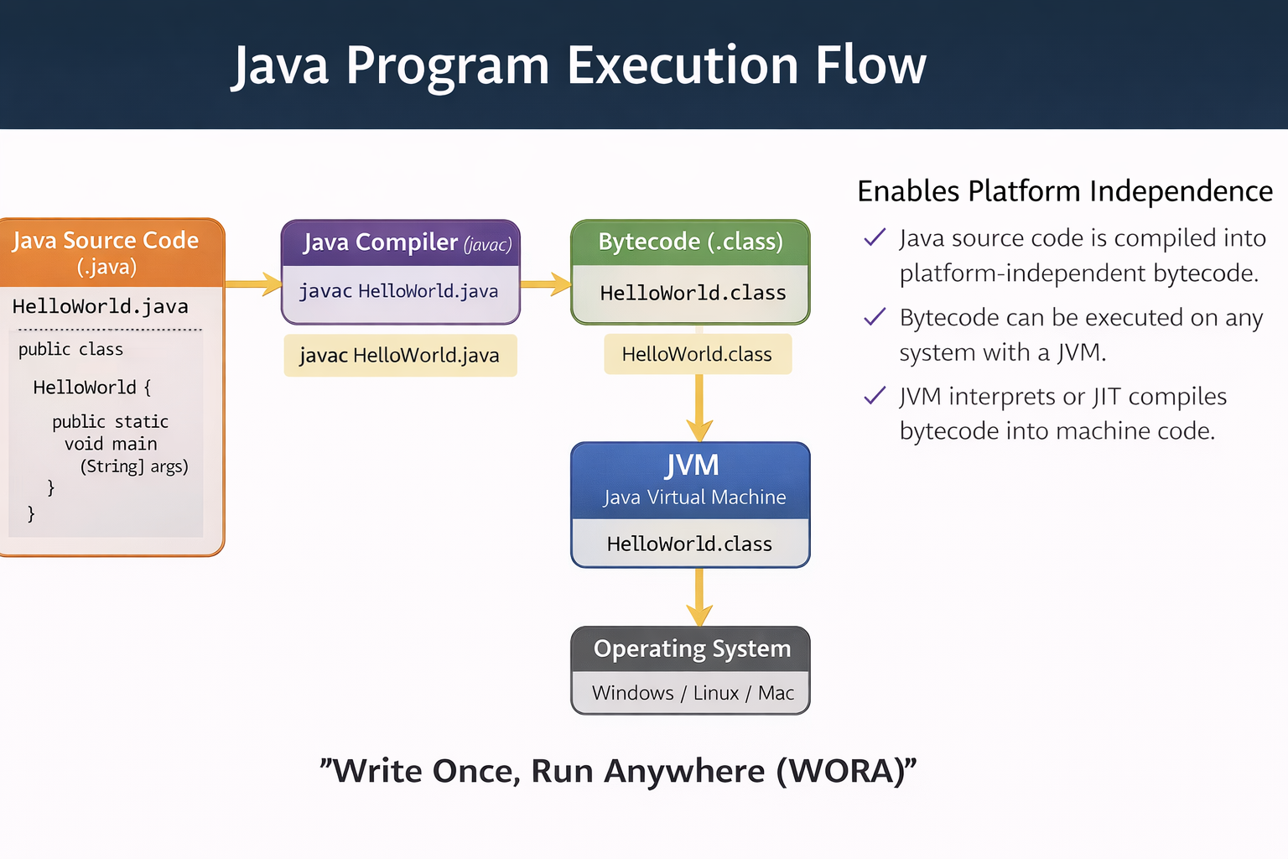
Java Architecture

Slide 3
Java Architecture
Java Source Code (.java)
Java Compiler (javac)
Bytecode (.class)
JVM executes bytecode
Platform Independence

Slide 4
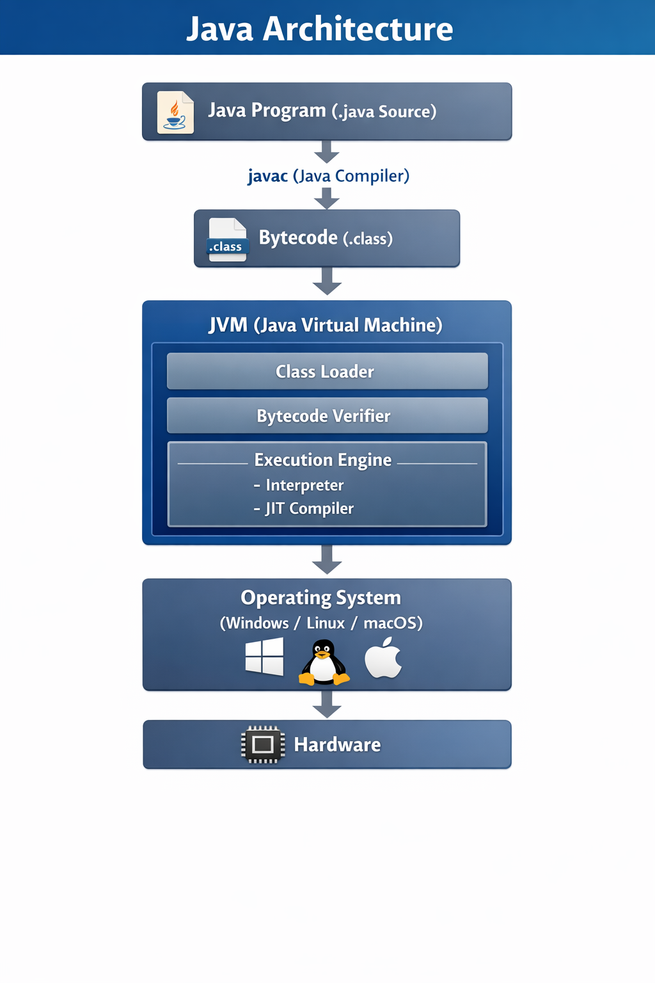
Java Architecture

Slide 5
Java Buzzwords
Simple
Object Oriented
Platform Independent
Secure
Multithreaded
Robust
High Performance

Slide 6
Path vs Classpath
PATH: Location of Java tools (javac, java)
CLASSPATH: Location of Java classes and packages
Example:
set PATH=C:\Java\bin
set CLASSPATH=.;C:\Java\lib

Slide 7
Sample Java Program
public class HelloWorld {
public static void main(String[] args){
System.out.println("Hello Masters Class");
}
}

Slide 8
Compile and Run Java Program
Compile:
javac HelloWorld.java
Run:
java HelloWorld
Output:
Hello Masters Class

Slide 9
Arrays and For-Each Loop
int[] nums = {10,20,30};
for(int n : nums){
System.out.println(n);
}

Slide 10
Class
A class in Java is a user-defined blueprint used to create objects. It defines the properties (variables) and methods (functions) that objects of that type will have.
Main parts of a class declaration:
Modifier – Defines access level (e.g., public, default).
class keyword – Used to declare a class.
Class Name – Usually starts with a capital letter by convention.
Superclass (optional) – A class can inherit from one parent using extends.
Interfaces (optional) – A class can implement multiple interfaces using implements.
Body { } – Contains variables, methods, and constructors.

Slide 11
Class
Example
public class Student extends Person implements Serializable {
int id;
String name;
void study() {
System.out.println("Student is studying");
}
}

Slide 12
Object
An object is the basic unit of Object-Oriented Programming (OOP) and represents a real-world entity. In a Java program, many objects are created, and they interact with each other by calling methods.
Key components of an object:
State – The attributes (variables) that describe the object's properties.
Behavior – The methods (functions) that define what the object can do.
Identity – A unique reference/name that distinguishes the object from others.

Slide 13
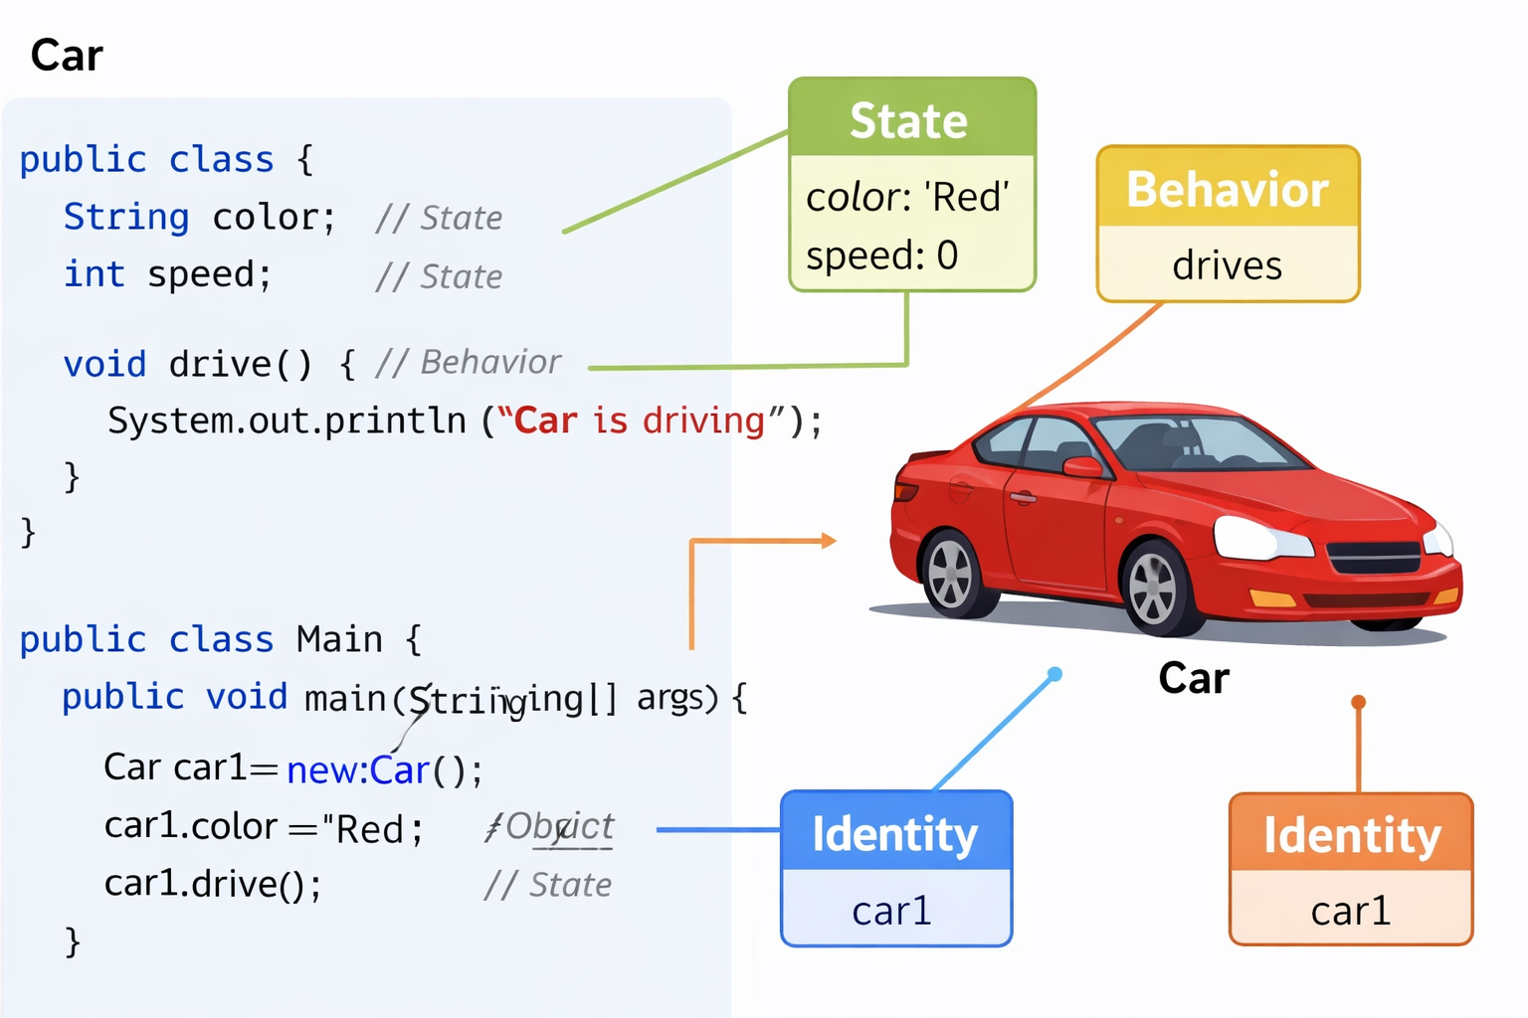
Example

Slide 14
Class and Object Example
class Student {
String name;
int age;
}
Student s = new Student();
s.name = "Ram";

Slide 15
Method Overloading
class MathUtil{
int add(int a,int b){ return a+b; }
double add(double a,double b){ return a+b; }
}

Slide 16
Inheritance and Overriding
class Animal{ void sound(){System.out.println("Animal sound");}}
class Dog extends Animal{
void sound(){System.out.println("Bark");}
}

Slide 17
Exception Handling
try{
int a = 10/0;
}catch(Exception e){
System.out.println(e);
}finally{
System.out.println("Done");
}

Slide 18
Custom Exception
class AgeException extends Exception{
AgeException(String msg){ super(msg); }
}

Slide 20
Java Concurrency
Thread States: New, Runnable, Running, Waiting, Terminated
Example:
Thread t = new Thread();
t.start();

Slide 21
Thread Synchronization
synchronized void print(){
System.out.println("Thread Safe");
}

